Slide 1





Netflix
Google Meet
Email
News
People
Movie
Google Drive
Chrome

Slide 2

Subject Subject Put Subject Here
Title of Presentation
Presentation Ready
Meet.google.com.memimop
Join now
Present

Slide 3

Subject Subject Put Subject Here
Members of the Group
Kang Seungyoon
Song Mino
Lee Seunghoon
Kim Jinwoo
Admit All

Slide 4
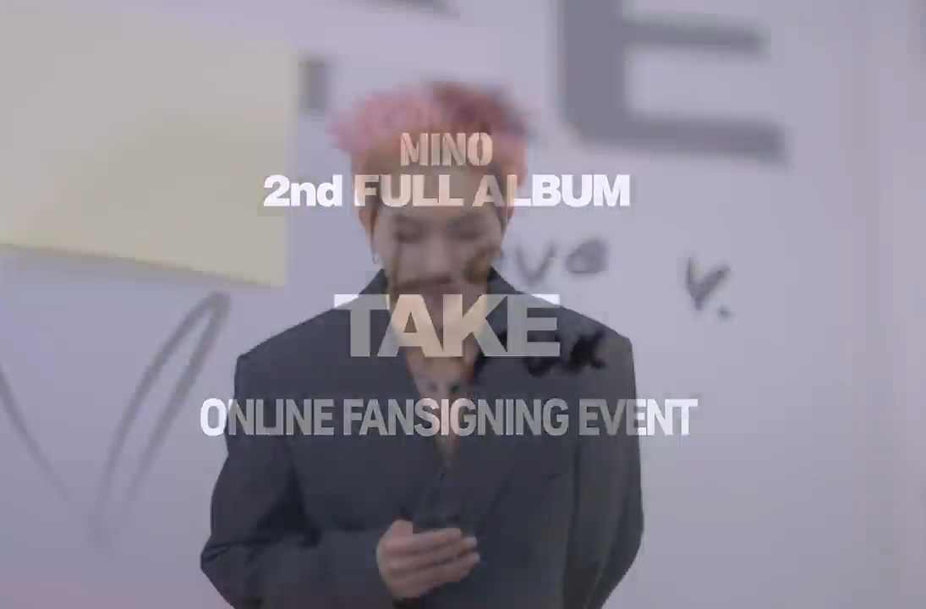

Subject Subject Put Subject Here
Song Mino is presenting…..
Reason To Stan Winner
WINNER is a group from South Korea, consist of four talented members. You should stan WINNER because they have good personality, self-produced group, funny, all visual, honest and SK love them.

Slide 5
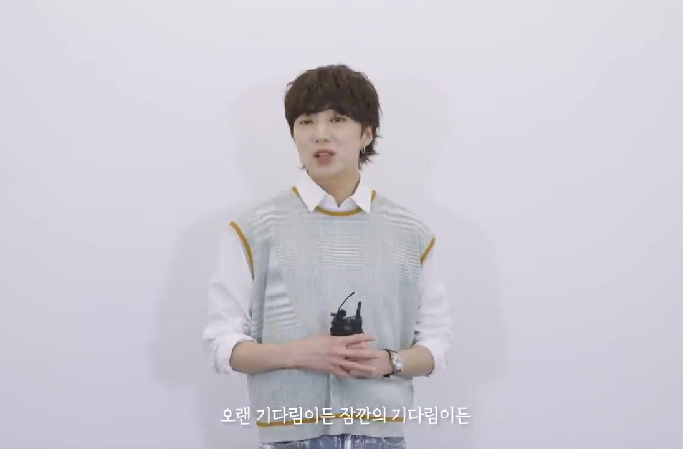
Subject Subject Put Subject Here
Kang Seungyoon is presenting…..
List of WINNER
Good Songs
FOOL
AIR
MY BAD
REMEMBER
SOSO
DON’T FLIRT
This will be endless list because all of their song is good even empty

